Slide 1

Project Synopsis Presentation on ONLINE-MONITORING OF PLANS AND COAL DATA
Presented by
PRITY KUMARI SHARMA(2017-21)
SHILA KUMARI(2017-21)
Under the Guidance of
Dr. Lalan kumar, Principal Scientist at CSIR-CIMFR(Dhanbad)

Slide 3
Content:
Introduction
Aim and Objective
Problem Definition
Project Plan
H/W & S/W Requirement, Team Structure.

Slide 4
Continued…
Implementation
Result and Discussion
Summary and Conclusion
References
Acknowledgement

Slide 5
Introduction:
It is a web based application for allocating various images and pdf files of mines plans and coal data.
The purpose of developing this application is to get rid of manual entry system.
It helps in keeping details about mines data and their plans.
This system eliminates duplicate data entry which occurs when carried manually.

Slide 6
Aim and Objective:
The main aims and objectives of developing this project:
Allocation of plans of mines data/coal data.
Reduce paper work.
Reduce time consumption.
Reduce man power.

Slide 7
Problem Definition:
The maintaining plans for long time get damages so now its can save online.
Requires internet connection.
Redundancy of data.
Time consuming
Lots of paper work.

Slide 8
Software Requirement Specification:
Functional Requirements:
R1: Registration Module-
Input: User_ id , Password ,user name,email.
Output: Successful registration.
Processing: The user details will be stored in registration- database.

Slide 9
Continue:
User Friendliness: This application has been developed keeping in mind the user friendliness.
Reliability and Efficiency: The application is found to be very reliable and consistently good to use.
Throughput: Throughput is the expected number of operations that can be performed in a unit of time.

Slide 10
Continue:
R2: Login Module-
Input: Username , Password.
Output: user will be redirect to the upload webpage.
Processing: The details enter by the user will be verified by the database.

Slide 11
Project Plan:
Hardware /Software Requirement
Minimum Hardware Specification:
Intel Core or above
1GB RAM
1TB Hard Disk
Minimum Software Specification:
Language Used : PHP, Bootstrap, HTML, CSS
Web Server: Internet Explorer/internet explorer
Database: MySQL

Slide 12
2. Team Structure
Fig:1. Team Structure
Project Guide
Member 1
Member 2

Slide 13
4. SDLC
Iterative Waterfall Model:
Feasibility
Study
Requirement Analysis and Specification
Design
Coding
Testing
Implementation and Maintenance
Fig: 3. Iterative Waterfall Model

Slide 14
Design:
Data Flow Diagram:
Request
Onlinemonitoring of plans and coal data
Response
user
upload
Response
Request

Slide 15
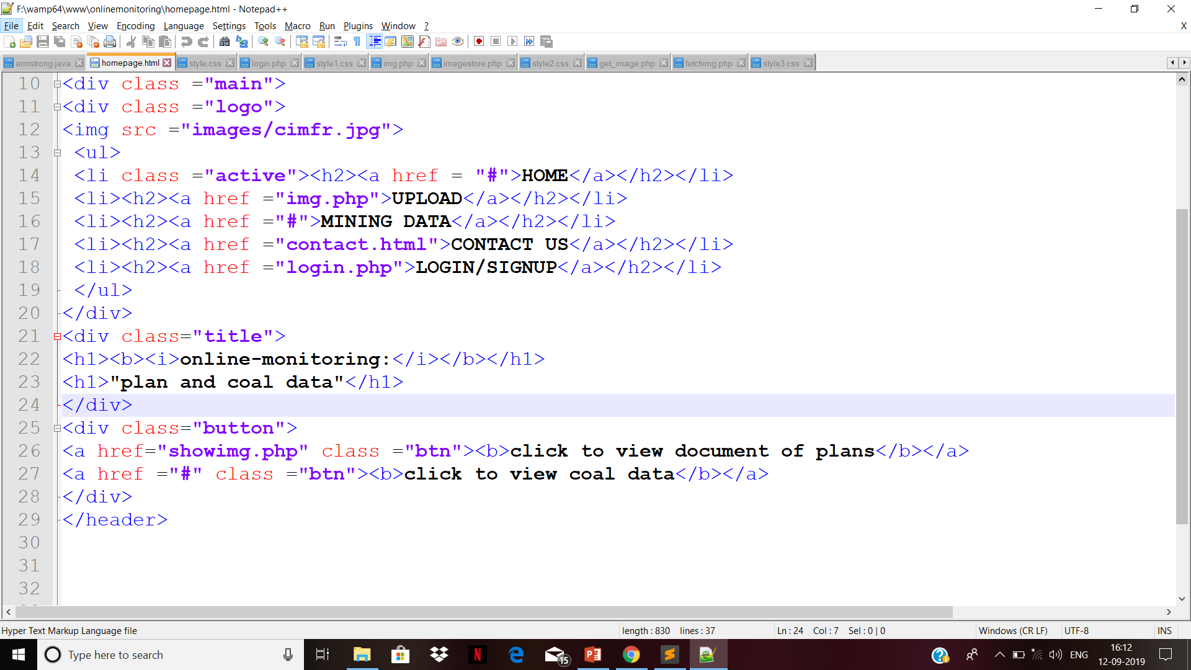
Implementation:
Screenshot of codes:-homepage

Slide 16

Continue:

Slide 17
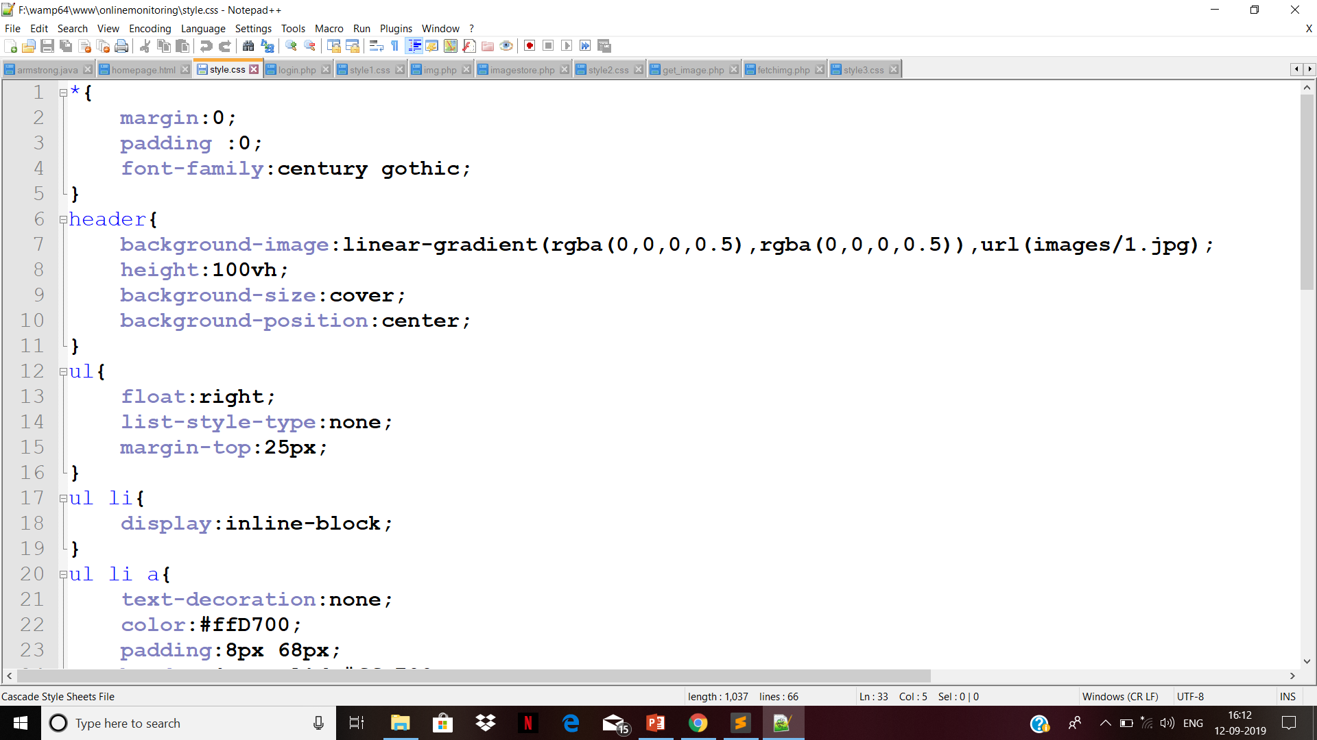
Continue: style-sheet of homepage

Slide 18
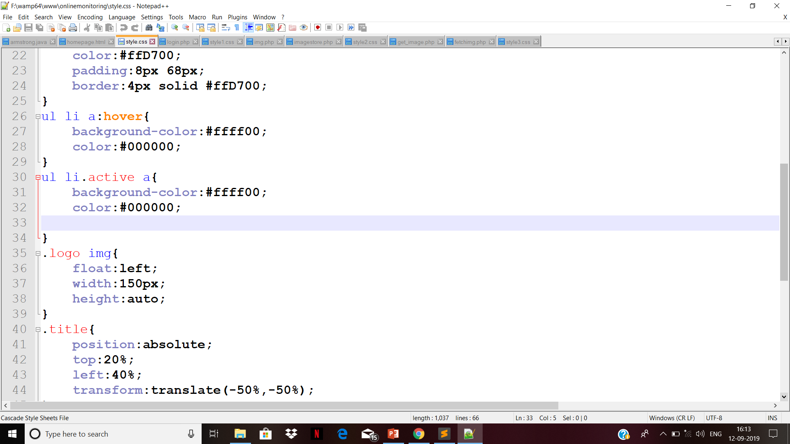
Continue:

Slide 19
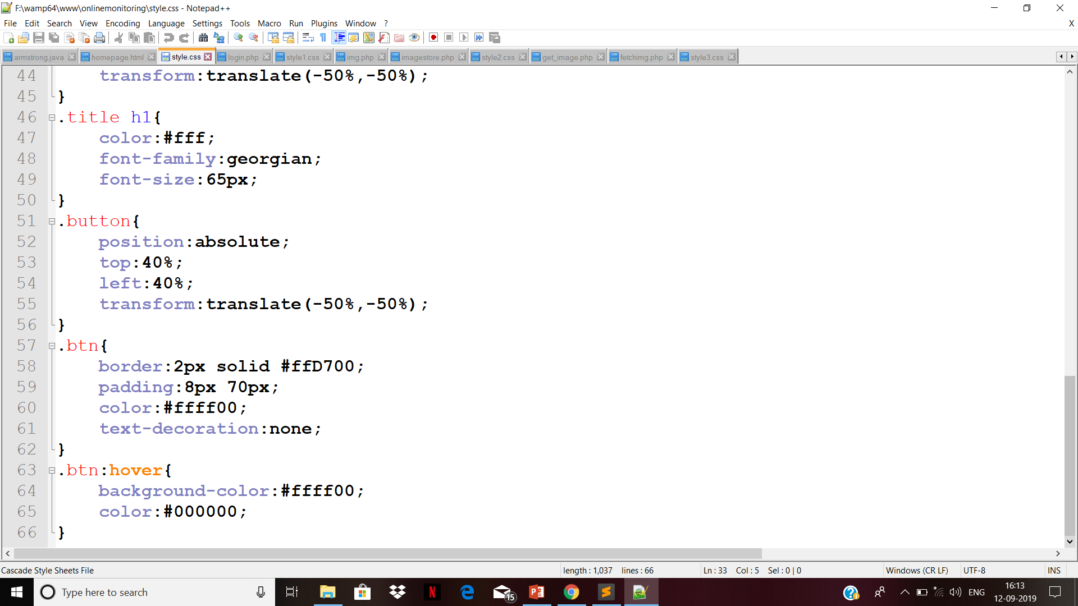
Continue:

Slide 20
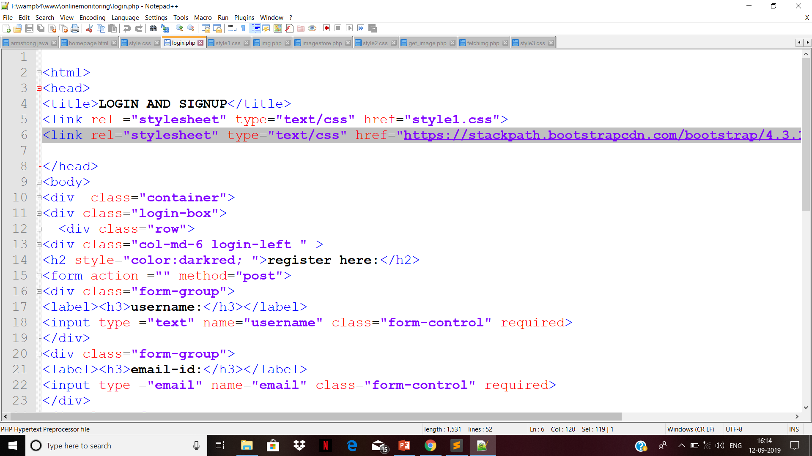
Continue: code of login/signup page

Slide 21
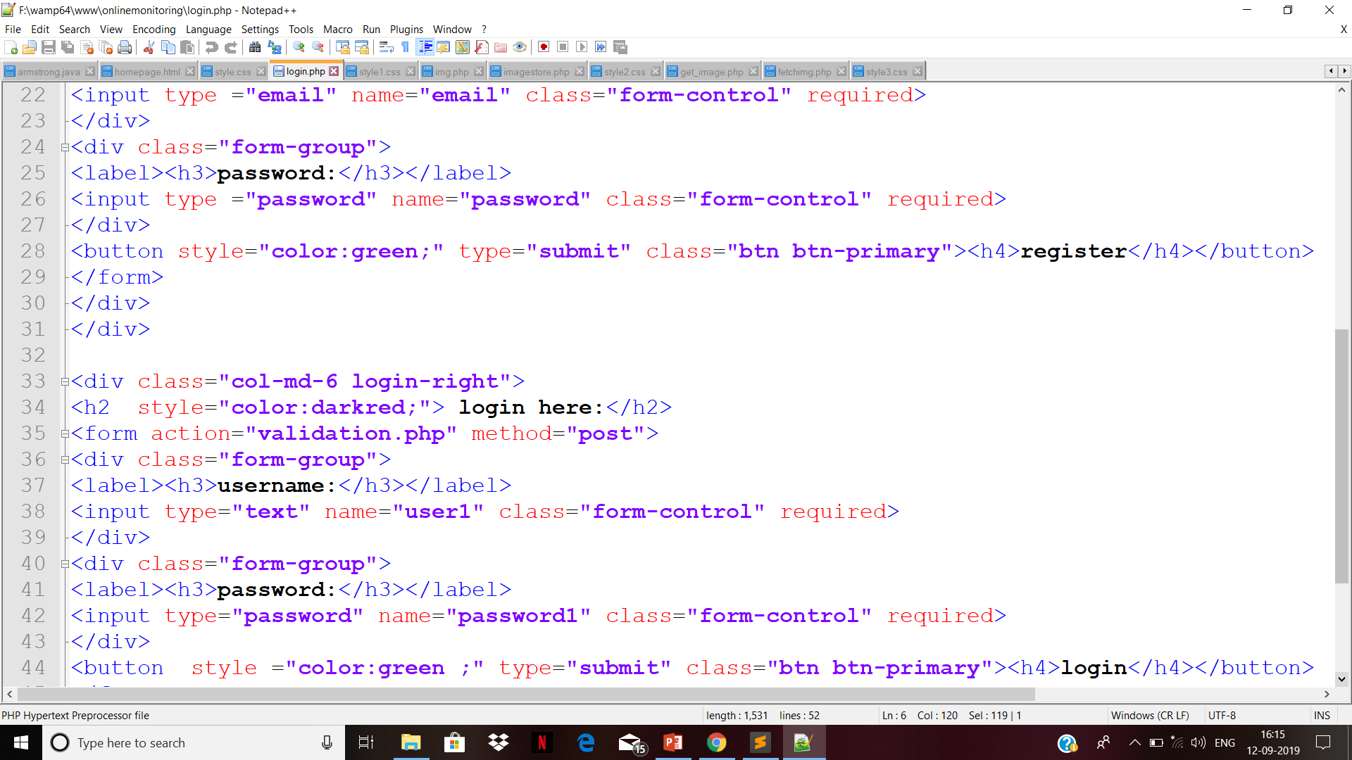
Continue:

Slide 22
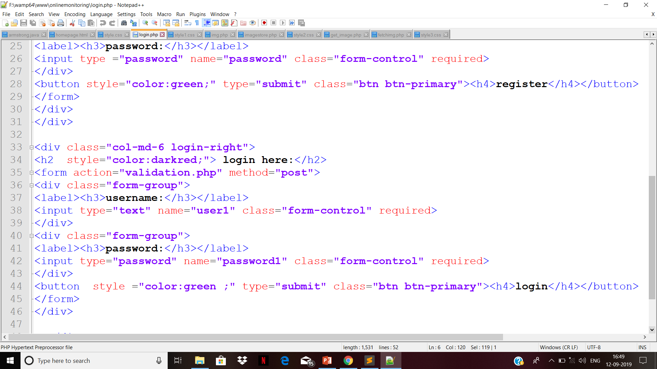
Continue:

Slide 23
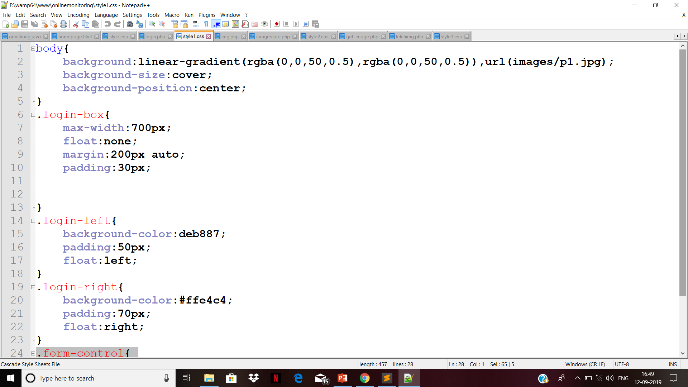
Continue:

Slide 24
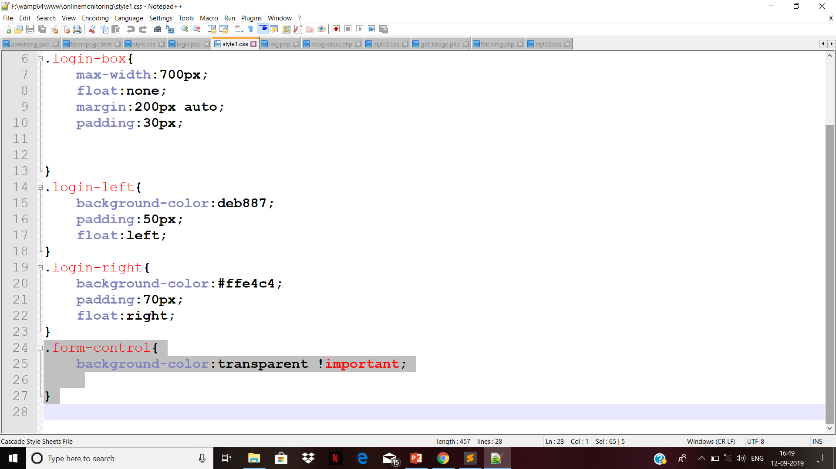
Continue:

Slide 25
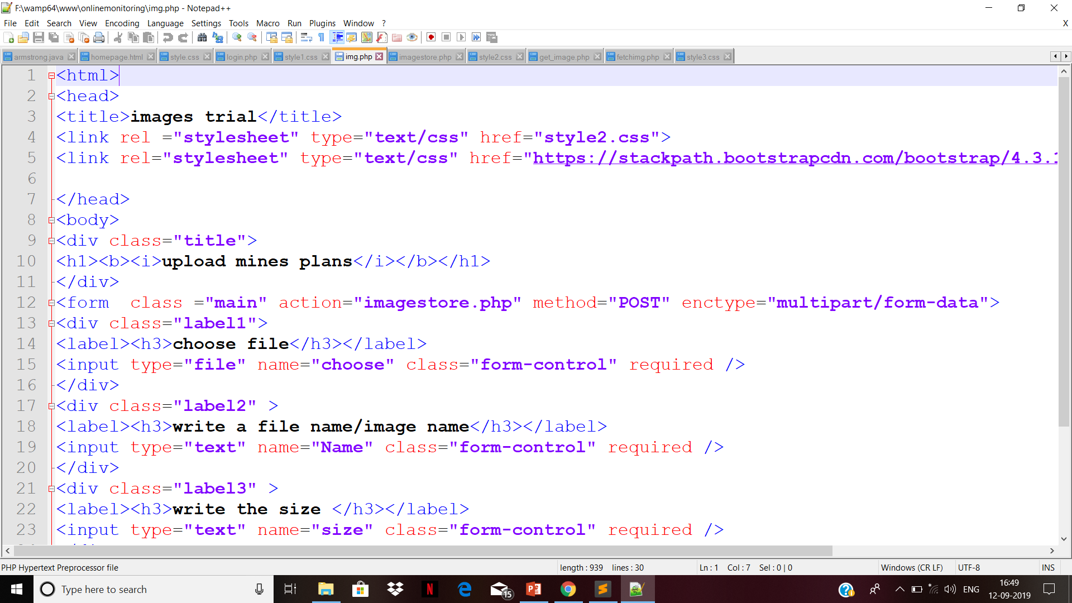
Continue: code of uploading image

Slide 26
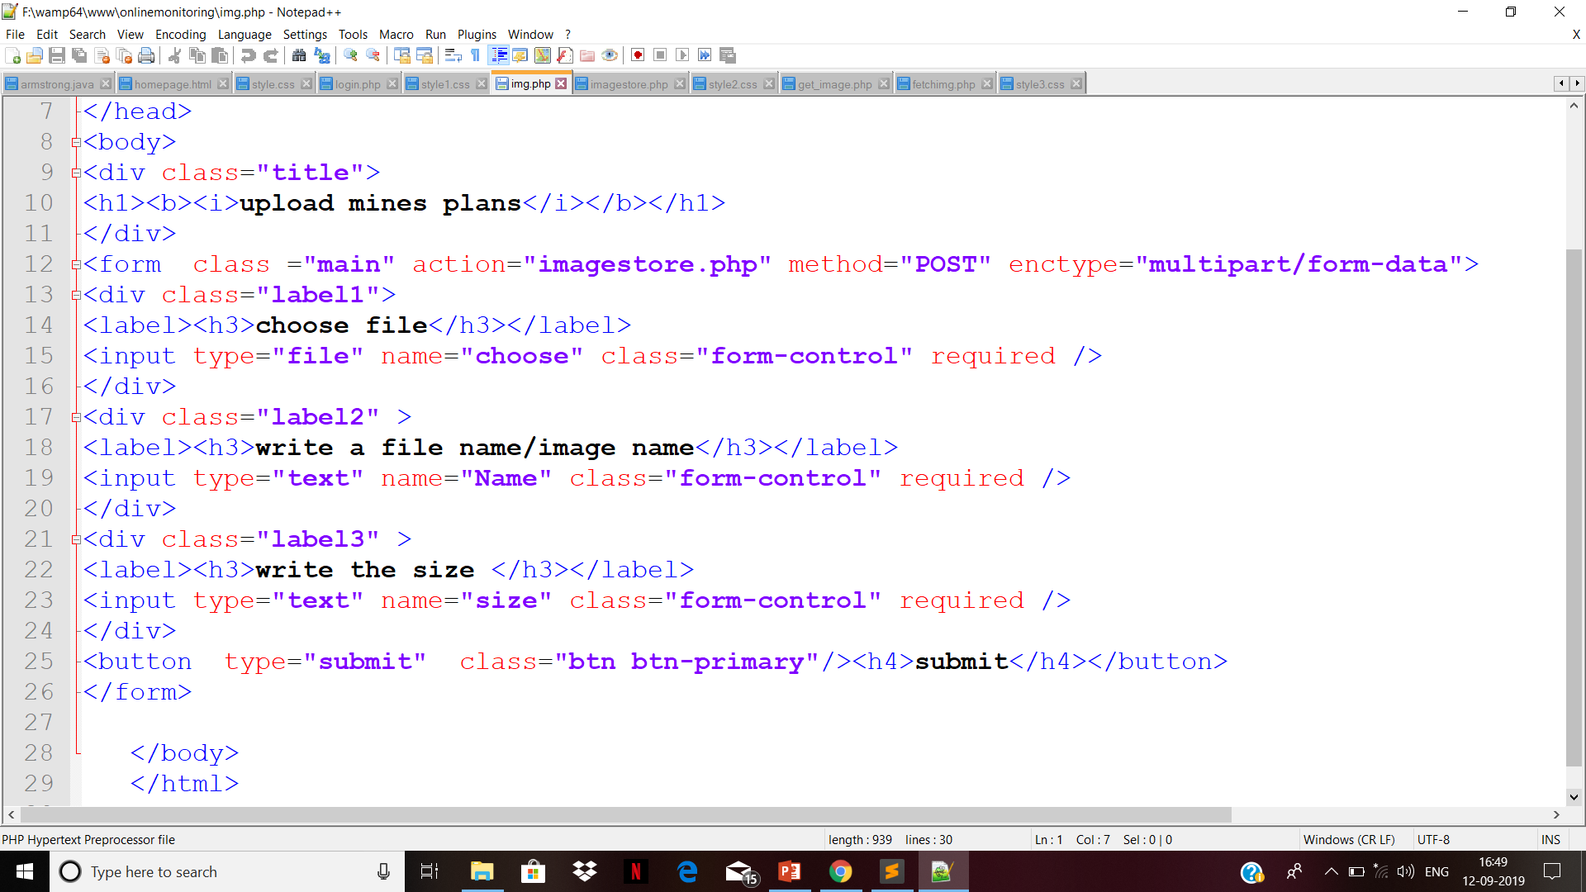
Continue:

Slide 27
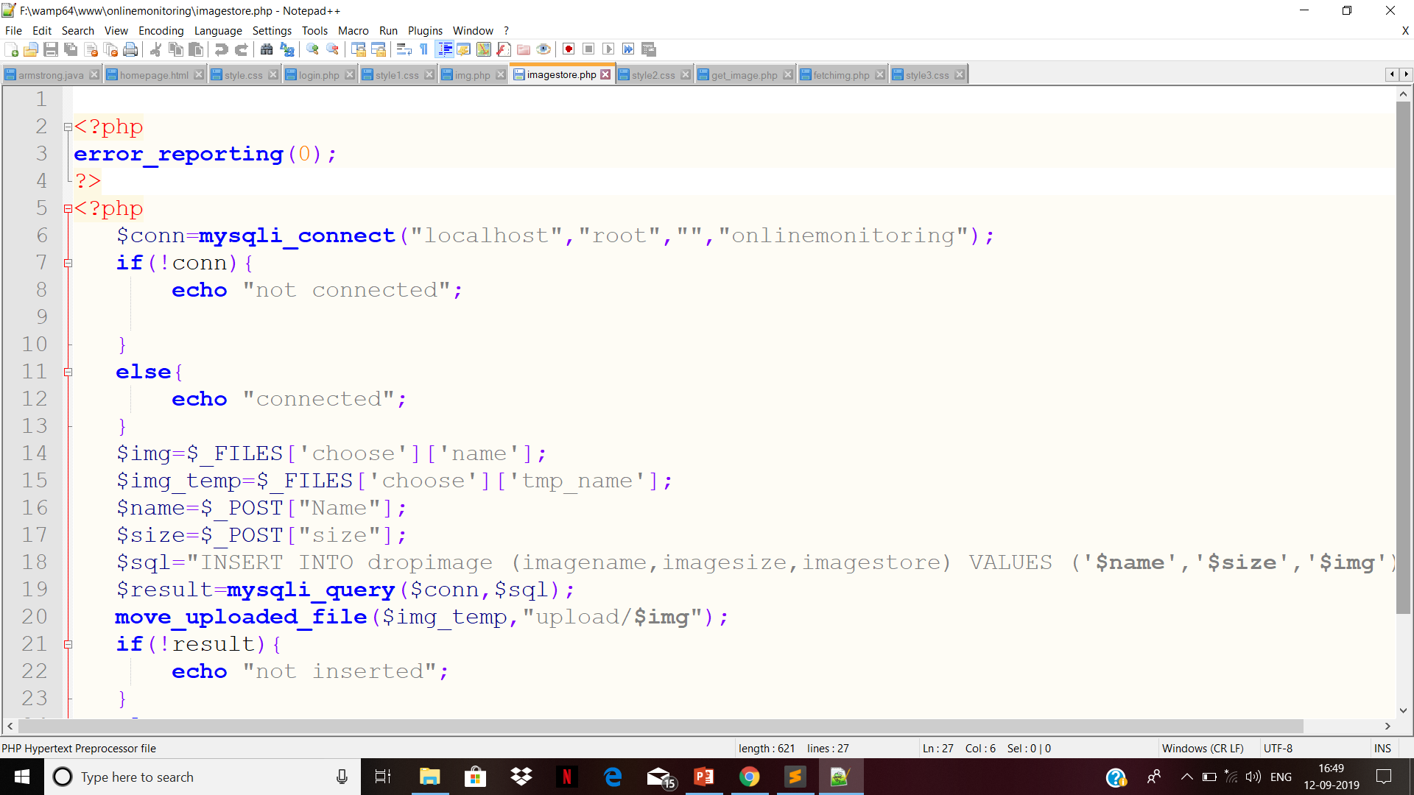
Continue: code of making connection of uploading page with database

Slide 28
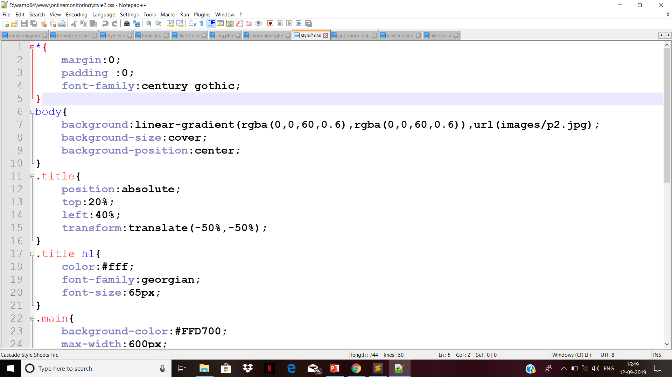
Continue: styling of uploading webpage

Slide 29
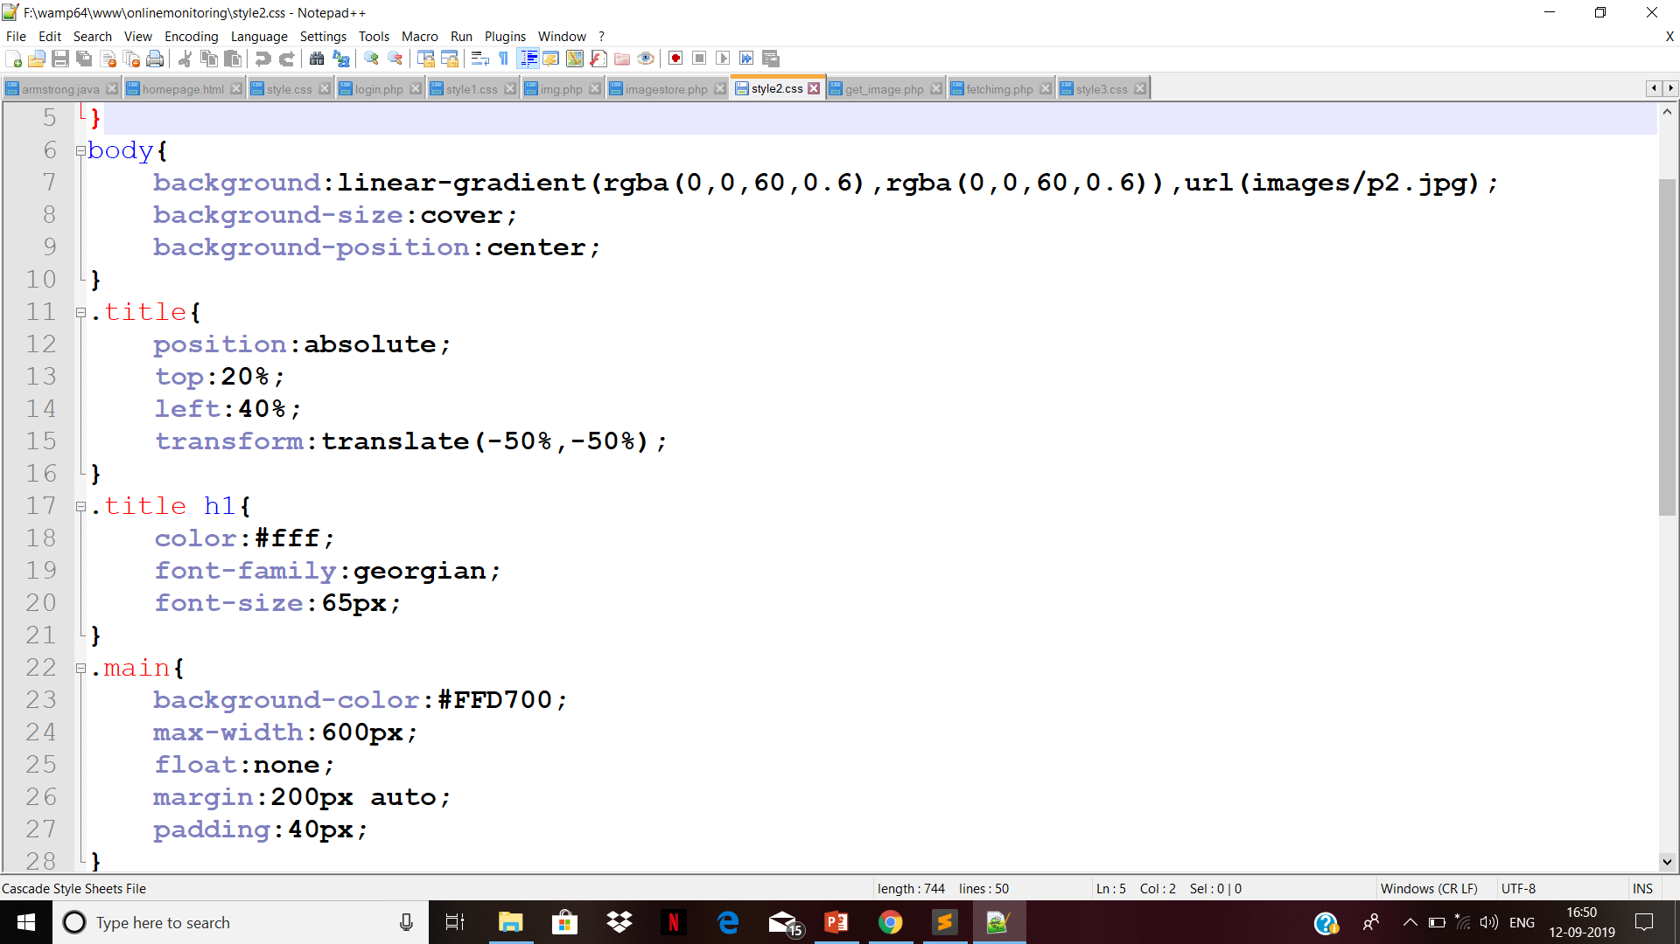
Continue:

Slide 30
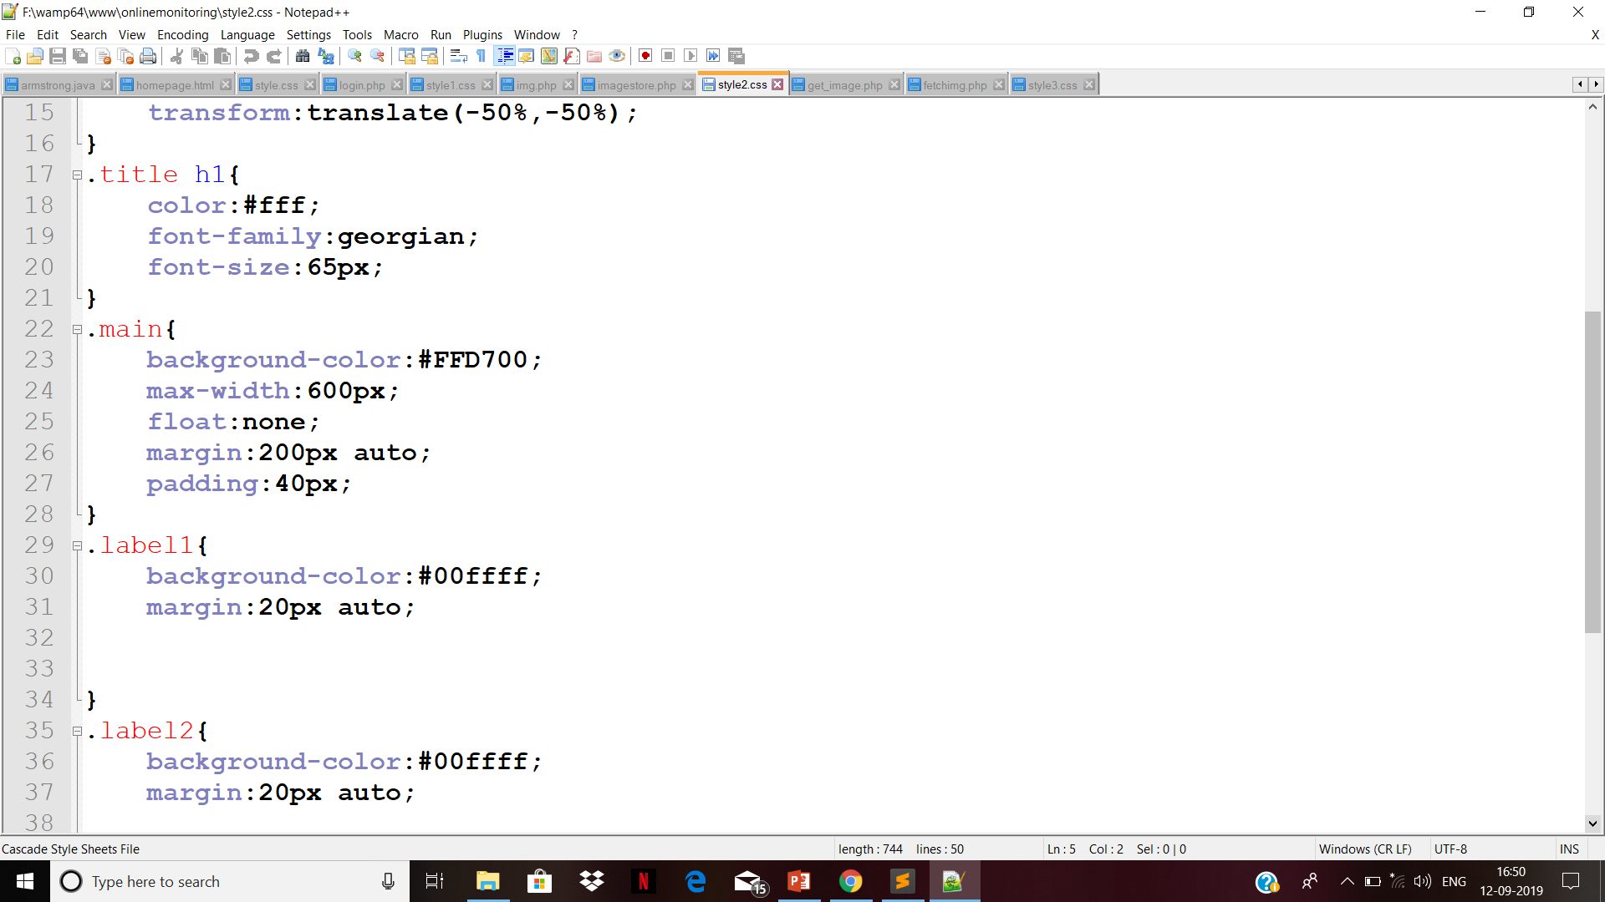
Continue:

Slide 31
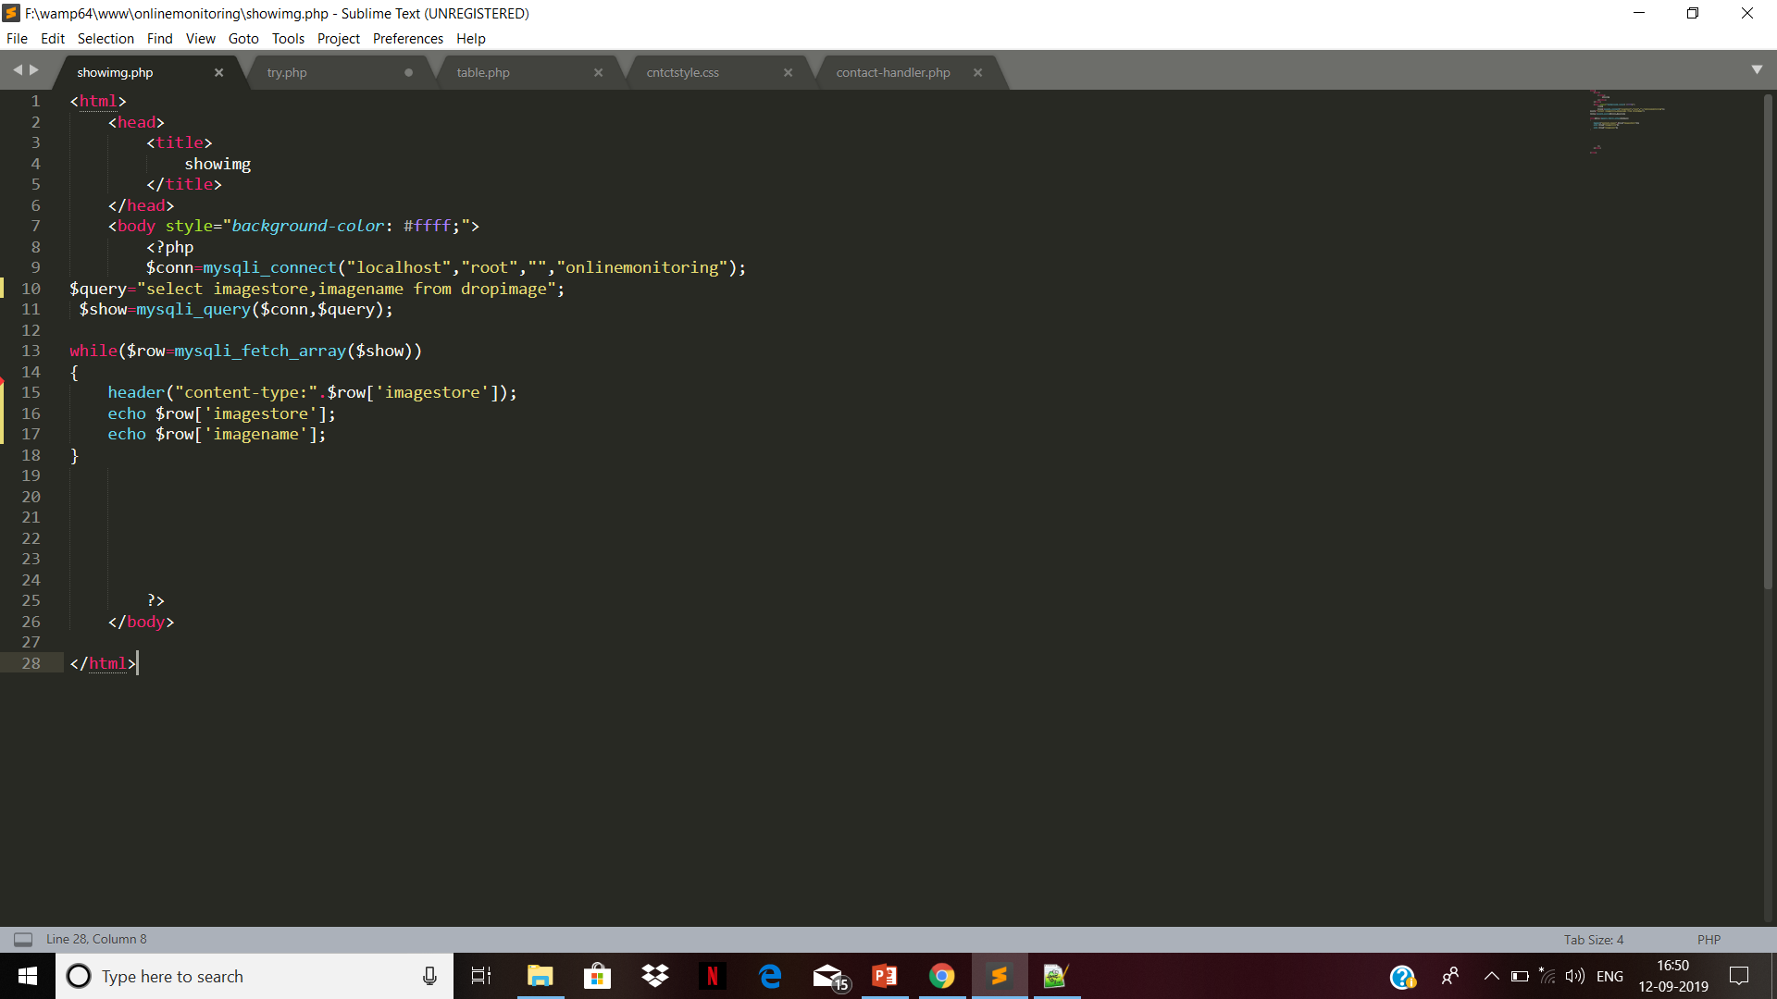
Continue: show image code

Slide 32
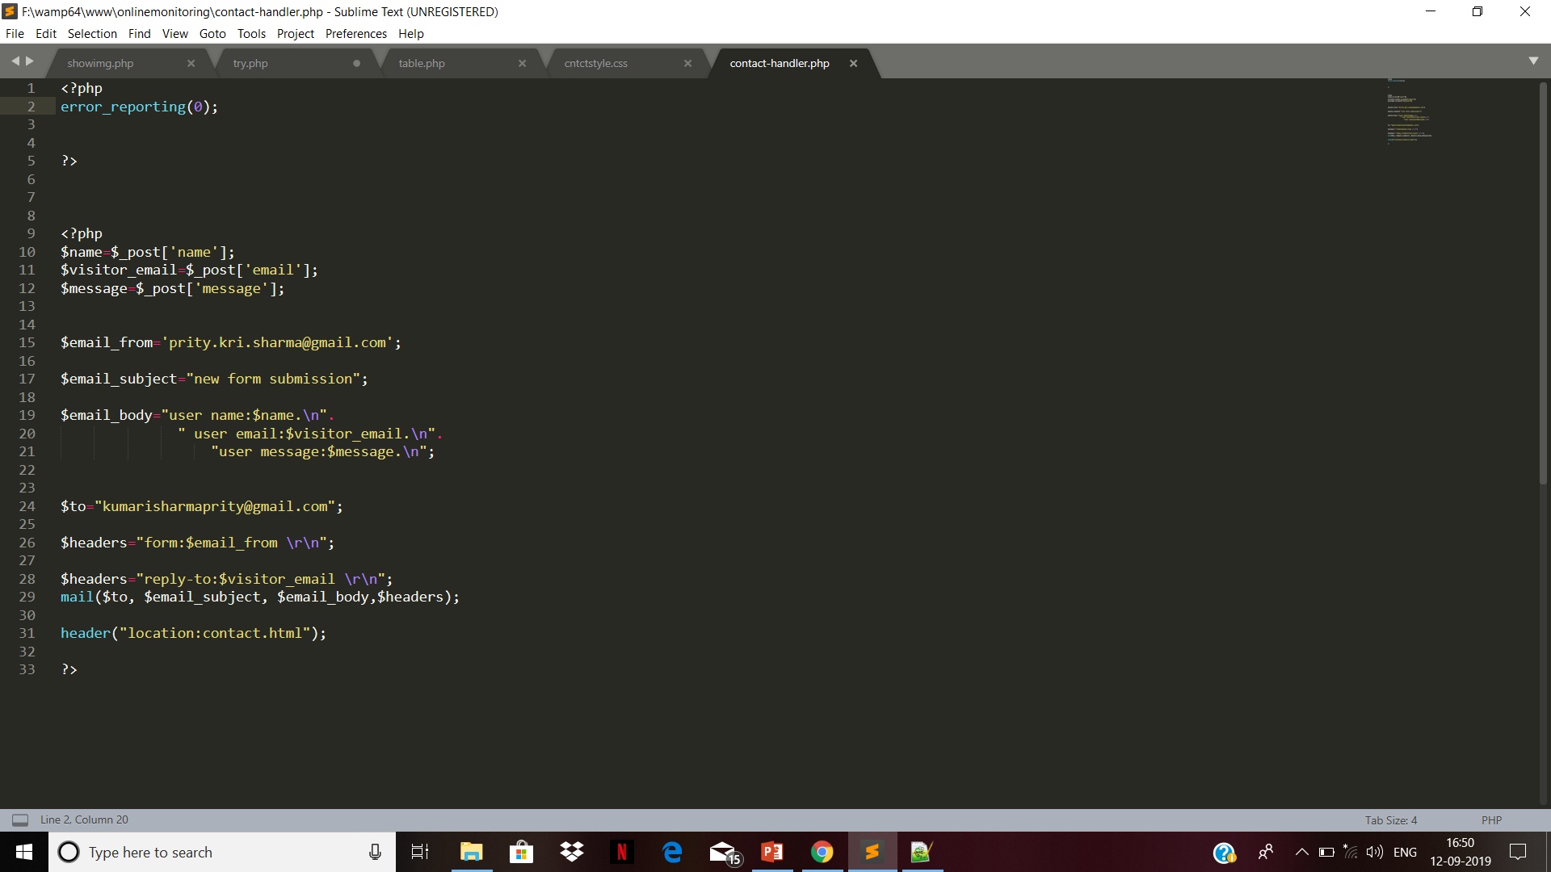
Continue:

Slide 33
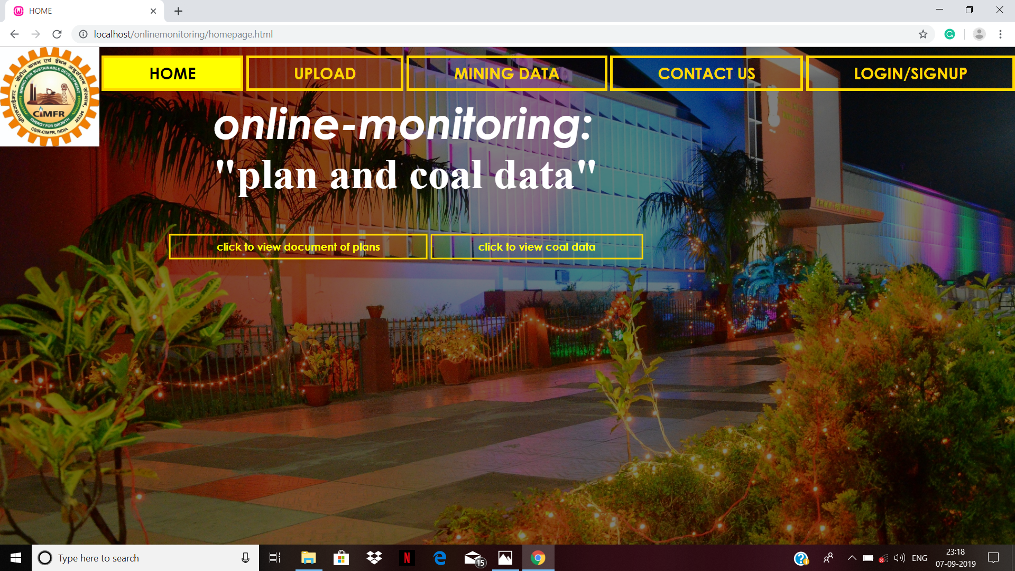
Result and Discussion: Home Page

Slide 34
About project :
This project is all about reducing the task of user maintaining the plans of mines data/coal data for long time ,they can acess their plans from anywhere when they upload to it on web application ,they can retrieve their uploaded files from database while after uploadation.it helps in works feseability and reduce stress.

Slide 35
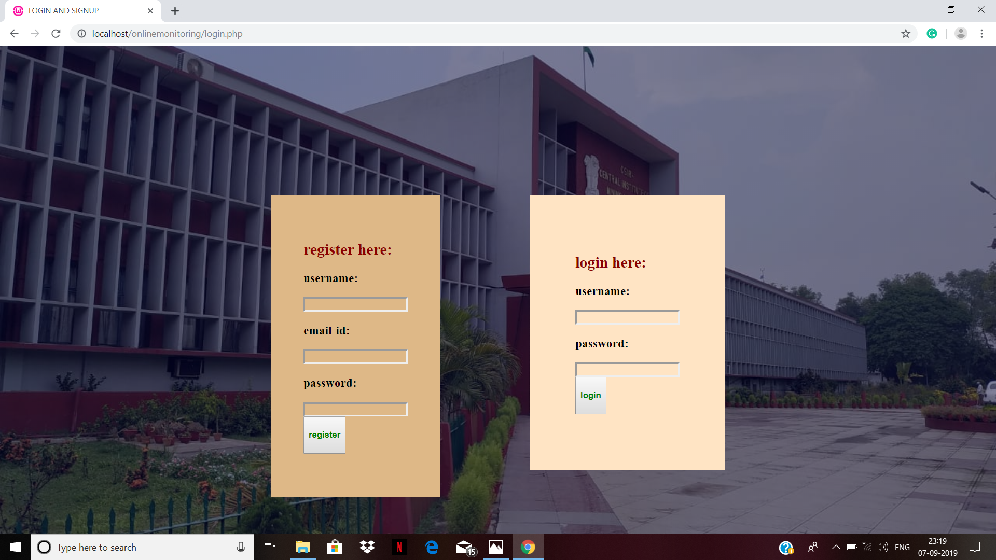
User Registration Page/log in page:

Slide 36
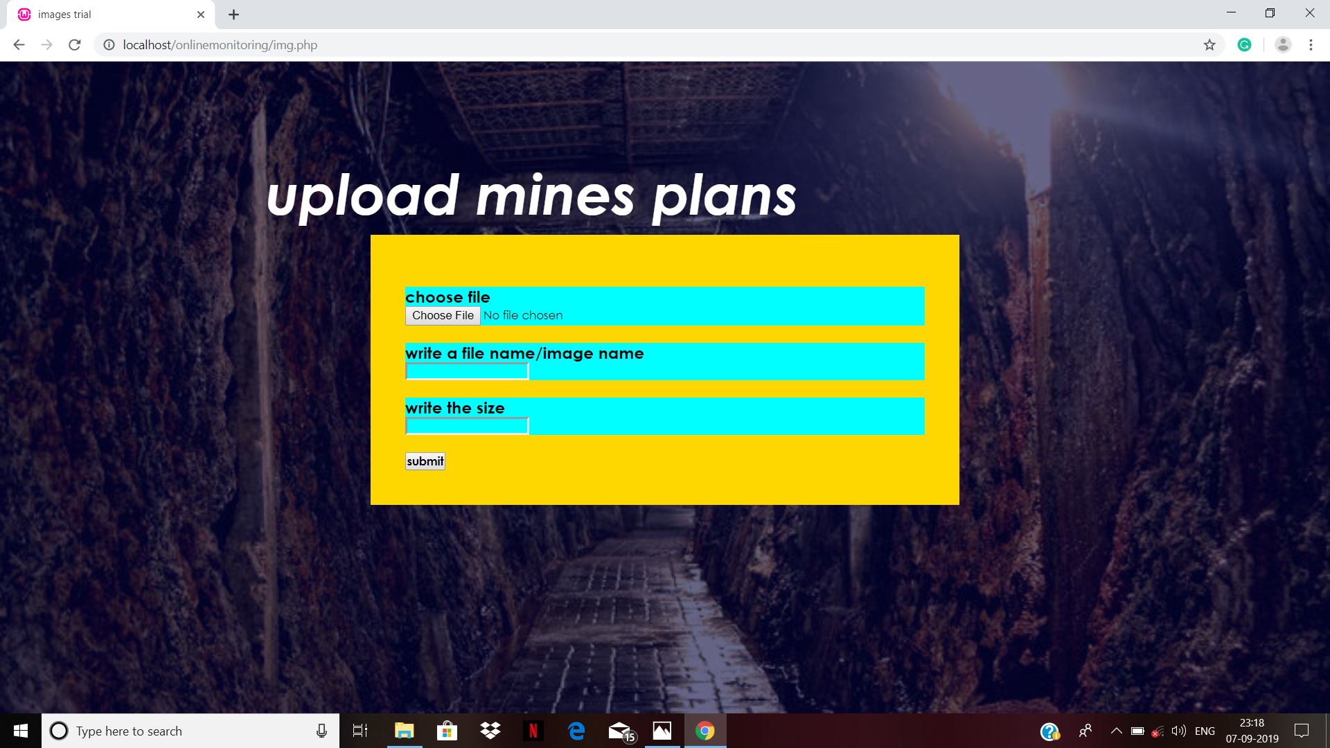
User image/file uploading page:

Slide 37
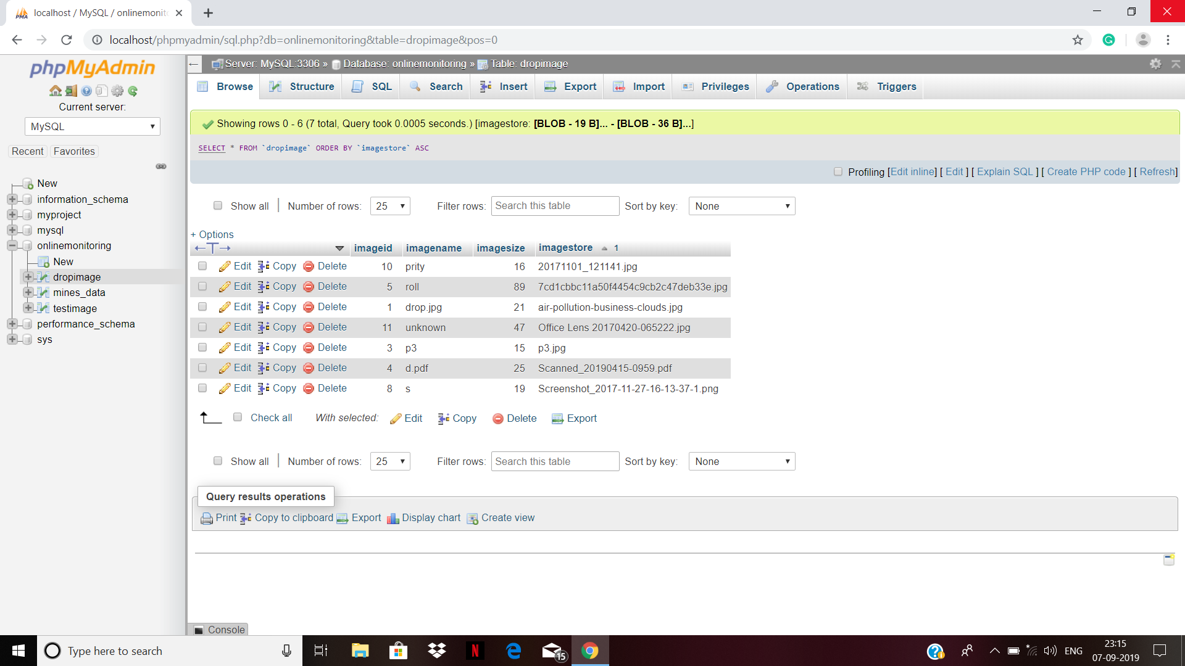
Database of uploaded image:

Slide 38
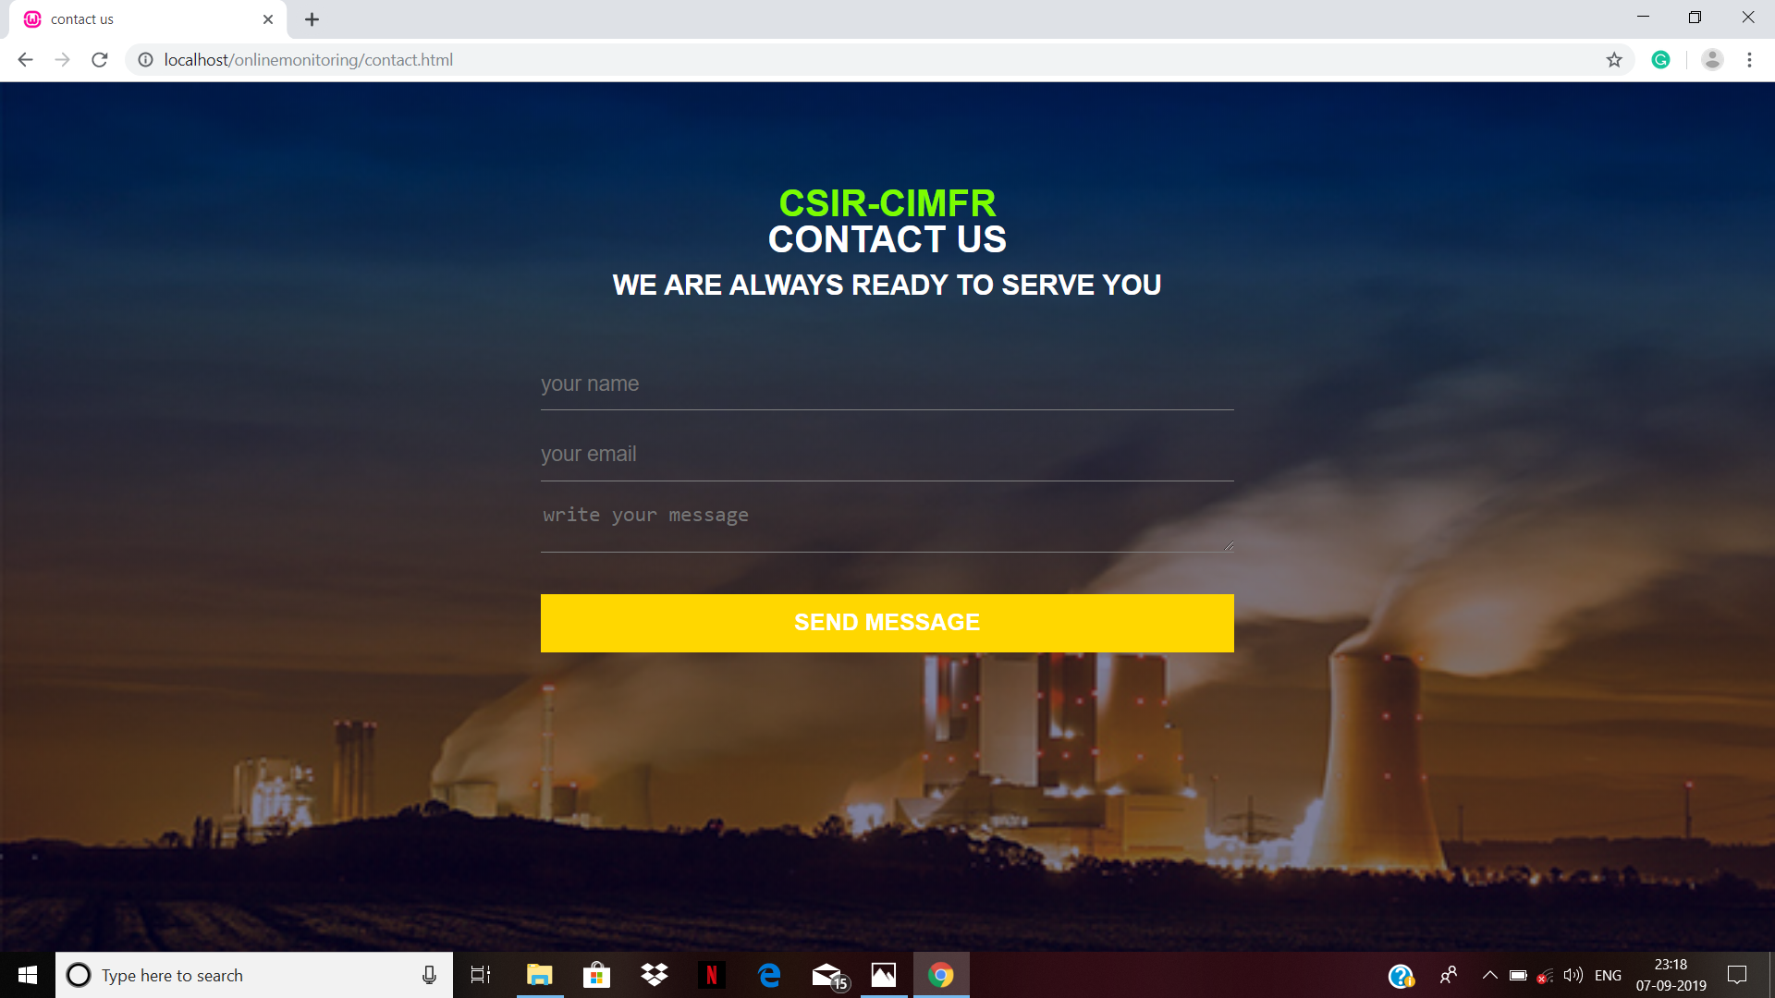
Contact us page:

Slide 39
Summary and Conclusion:
The project holds the detail of the progress of the uploading files of mines data application.
The proposed application has been successfully completed using PHP as the developing environment and SQL as the backend server.
Through the use of this application user requests to go to upload web page and upload their desires files.

Slide 40
Summary of achievements:
In the project work, successfully “online monitoring of plan and mines data/coal data ” is developed.
This ap.
The searching of student details are solved by this application.

Slide 41
Problem faced during project:
During developing our project we faced lots of difficulties.
Firstly, we did not had proper knowledge of the programming language we used.
We also encountered difficulties in the validation of login form, password validation.
We also faced problem in connection of the database.

Slide 42
Future scope of the project:
Mobile base application can be developed for easy use.
Interface can be made more attractive.

Slide 43
Limitation of the project:
The following are the limitations of the application:
User requesting for viewing the plan of mines must be within the mines state.

Slide 44
Conclusion:
This system is very useful for the collecting pictures about planes of mine saving it for future use.
It reduces paperwork and time consumption.

Slide 45
References
Jason Lengstorf, Apress “PHP for Absolute Beginners”, 3rd Edition.
Google and youtube.

Slide 46
Acknowledgement
We respect and thank to Dr.lalan kumar for the guidance and suggestions throughout our project.
We thank our HOD Ma’am Dr. Geeta Sinha for letting us do the project.
And all of my colleague and my team members for their cooperation and supports.

Slide 47
THANK YOU

